Slide 1


Analysis & Design 30 Day Guitar Bootcamp
Joshua Ruben Pop

Slide 2


General Presentation
The project presented in this document is a website called “30-Day Guitar Bootcamp.” The idea is to guide users through 30 interactive lessons over the course of a month, covering everything from basic music theory to essential guitar techniques. The goal isn’t to make someone a master guitarist in 30 days, but rather to give them a solid foundation in guitar fundamentals and, ideally, help them learn to play at least one simple song by the end of the program.

Slide 3
Theoretical Fundamentals
Music Theory Foundations
The project is based on the fundamental concepts of music theory, which serve as the building blocks for learning guitar. These include:
Scales and Keys: Introduction to major and minor scales, which form the basis for melodies and chord construction.
Chords and Harmony: Basic triads (major, minor, diminished) and how they are formed from scales.
Rhythm and Timing: Understanding time signatures, beats, and tempo to maintain consistent strumming patterns.
Chord Progressions: Common progressions (e.g., I–IV–V, ii–V–I) that are used in countless songs.

Slide 4
Theoretical Fundamentals
Web Development Fundamentals
From a technical perspective, the website relies on standard web technologies and design principles:
Frontend Development: Built using HTML, CSS, and JavaScript (or frameworks like React) for interactive, responsive interfaces.
Backend and Data Management: Handles user progress tracking, lesson data, and authentication securely (e.g., via Node.js, Python, or a CMS).
User Experience (UX) Design: Focused on intuitive navigation, minimal distractions, and accessibility across devices.

Slide 5
IT Technology
Front-End
The front-end represents the part of the website that users directly interact with. It focuses on design, usability, and interactivity.
HTML (HyperText Markup Language): Provides the basic structure and content of the web pages.
CSS (Cascading Style Sheets): Defines the visual style, including colors, layout, and responsive design.
JavaScript: Adds interactivity and dynamic behavior, enabling features such as lesson navigation, user input handling, and real-time updates.
Back-End
The back-end handles the logic, data processing, and storage that support the front-end. It manages user accounts, lesson progress, and other dynamic data.
Javascript.
Database: Stores user information, lesson data, and progress tracking. PostgreSQL

Slide 6
Functionalities
User Registration and Authentication
Allows users to create accounts, log in, and save their progress.
Ensures secure handling of personal data through authentication protocols.
Interactive Lessons
Provides 30 structured lessons covering music theory, guitar techniques, and practice exercises.
Includes multimedia elements such as videos, diagrams, and audio examples.
Lessons are presented progressively to guide users from basic to intermediate skills.
Progress Tracking
Tracks completed lessons, practice sessions, and achievements.
Displays visual indicators (e.g., progress bars) to motivate continued learning.
Quizzes and Assessments
Short quizzes at the end of lessons to test user understanding.

Slide 7
Actors and related access rights
Learner (Registered User):
Learners are the main users of the platform who follow the 30-day lessons. Their access rights include:
Creating and managing their account
Accessing all lessons and quizzes
Tracking their learning progress
Replaying or pausing lessons
Viewing achievements and badges
3. Administrator:
Administrators manage the website content and user accounts. Their access rights include:
Adding, editing, or removing lessons
Managing user accounts and permissions
Monitoring user activity and reports
Updating website settings

Slide 8
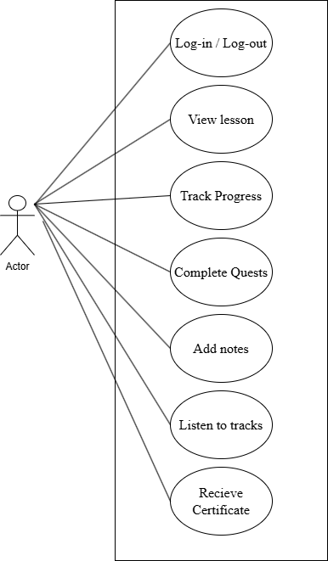
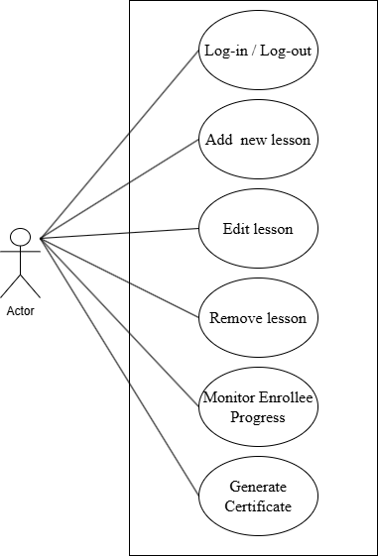

Use Case Diagrams

Slide 9
System Architecture
7.1 Front-End (Client Side):
Built using HTML, CSS, and JavaScript.
Handles the user interface, including lesson content, quizzes, progress tracking, and interactive elements.
Ensures responsive design for accessibility on desktops, tablets, and mobile devices.
Communicates with the back-end to retrieve and display dynamic data.
7.2. Back-End (Server Side):
Processes user requests, manages lesson content, and stores user data.
Handles authentication, authorization, and progress tracking.
Interacts with the database to store and retrieve information securely.
Can be implemented using technologies such as Node.js, Python, or PHP.
7.3. Database:
Stores user accounts, lesson data, progress records, and quiz results.
Can be implemented using relational databases (e.g., MySQL) or NoSQL databases (e.g., MongoDB).
7.4. Interaction Between Components:
The front-end sends requests to the back-end via APIs to fetch or update data.
The back-end processes these requests, interacts with the database, and sends responses back to the front-end.
This separation ensures modularity, scalability, and easier maintenance of the website.

Slide 10
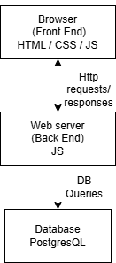
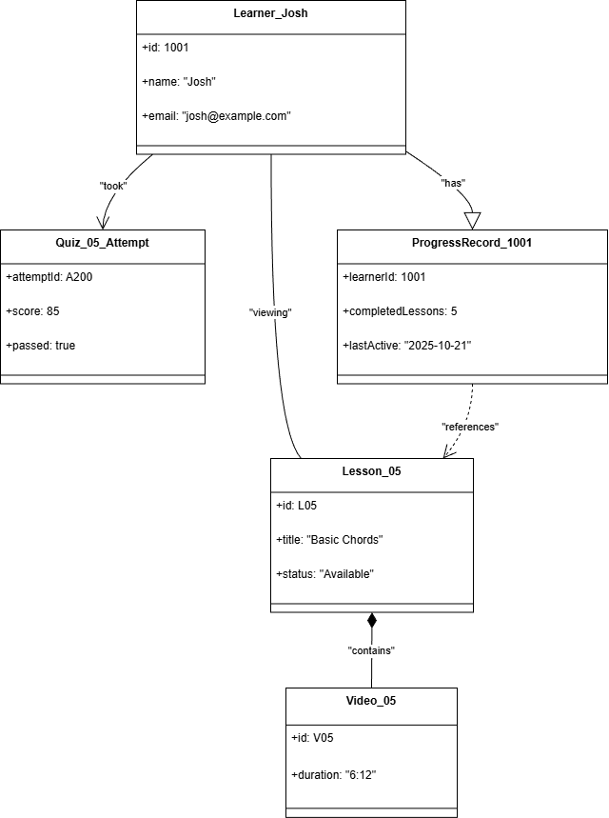
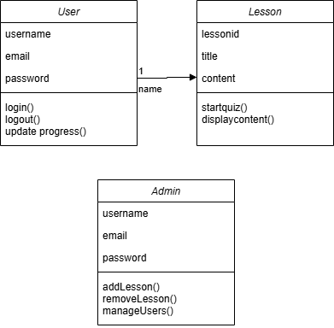
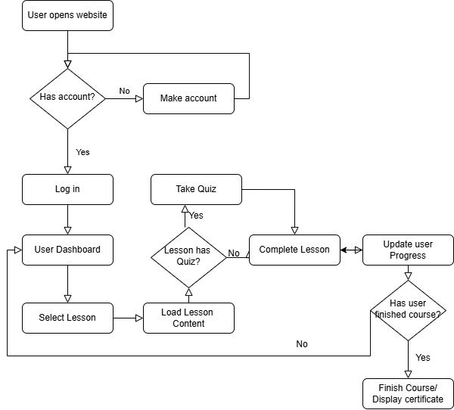
Design Diagrams
General architecture
Object diagram
Class diagram
Flow chart

Slide 11
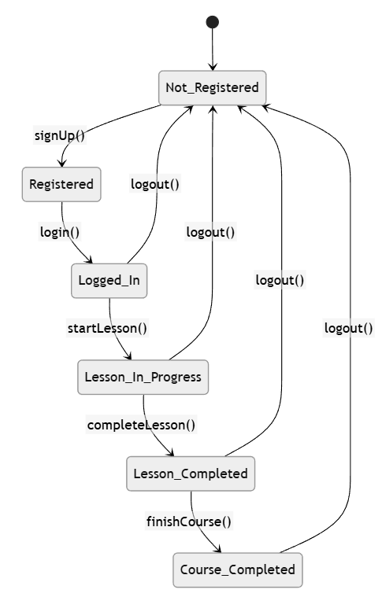
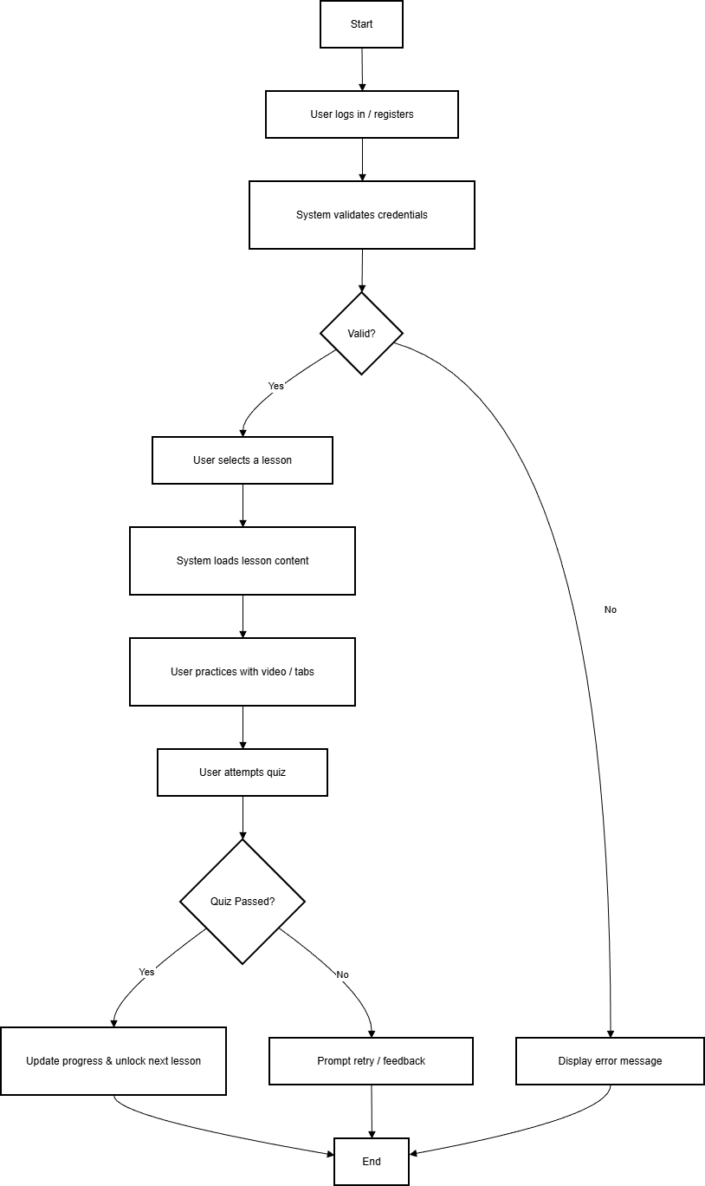
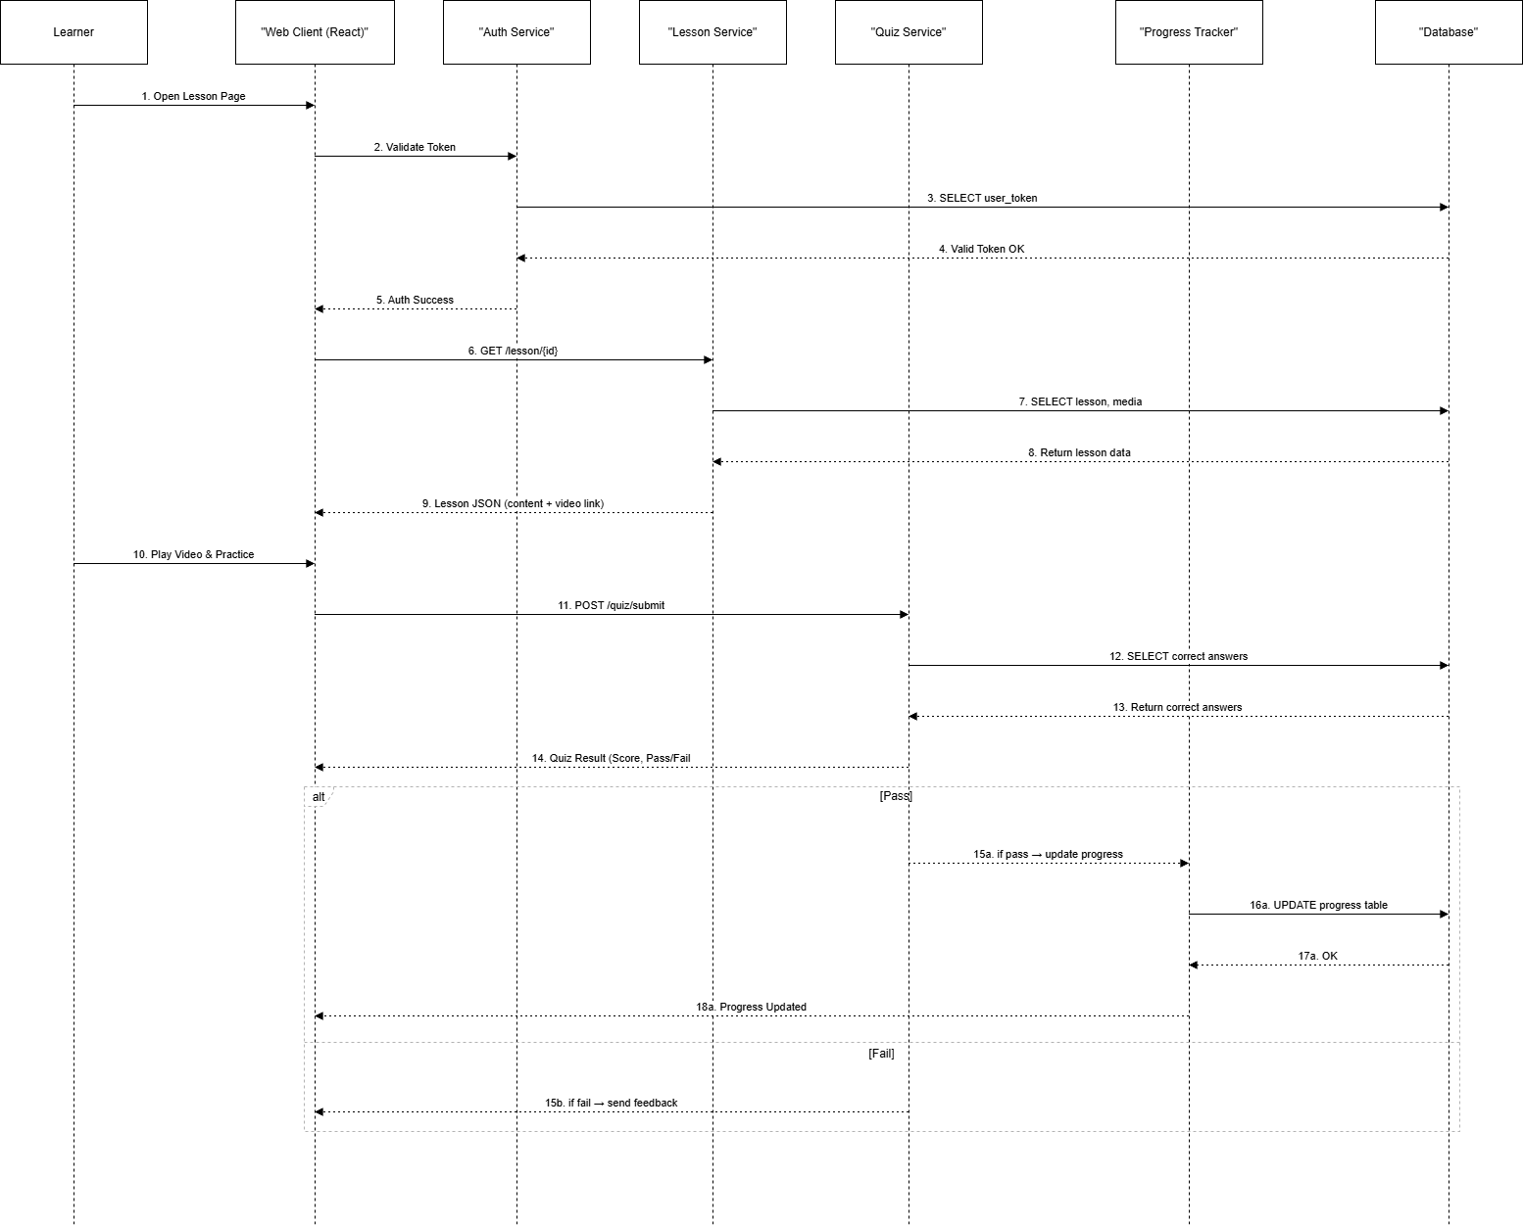
Design Diagrams
State transition diagram
Activity diagram
Sequence diagram

Slide 12
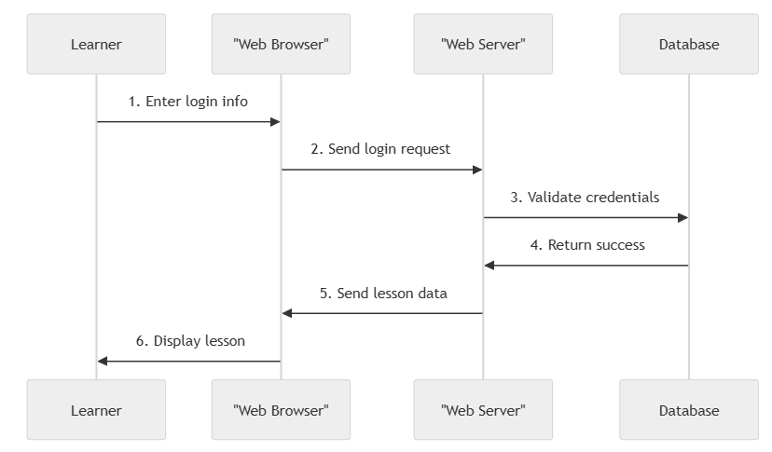
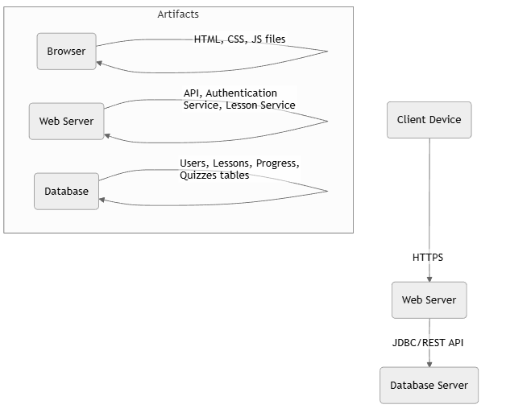
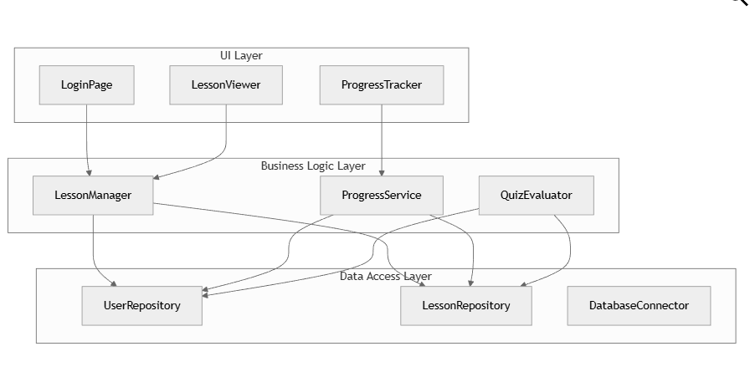
Design Diagrams
Communication diagram
Deployment diagram
Package diagram

Slide 13

Operation Mode
Logo / Front page design

Slide 14
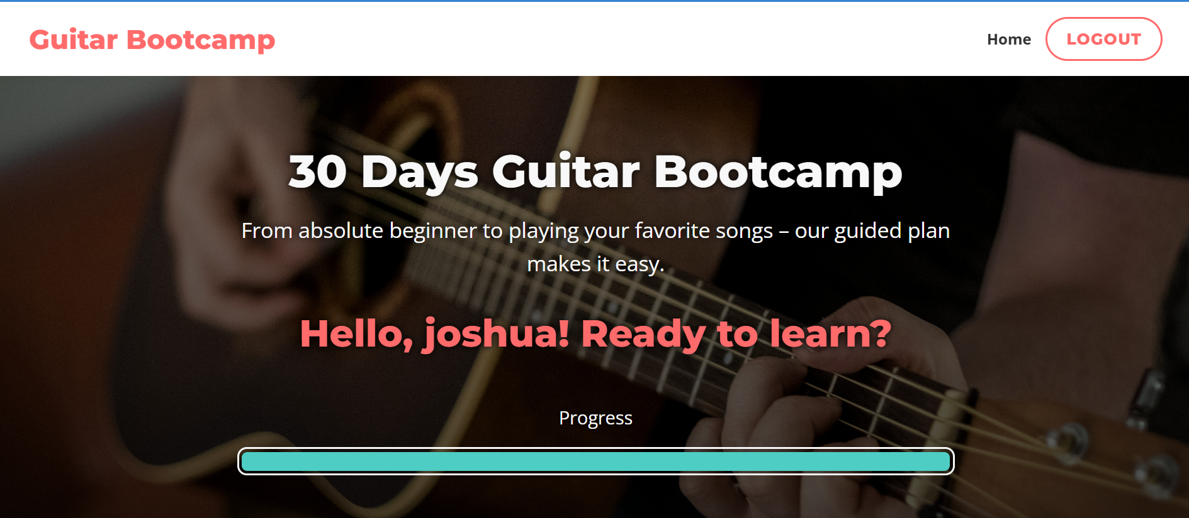
Ui design

Slide 15
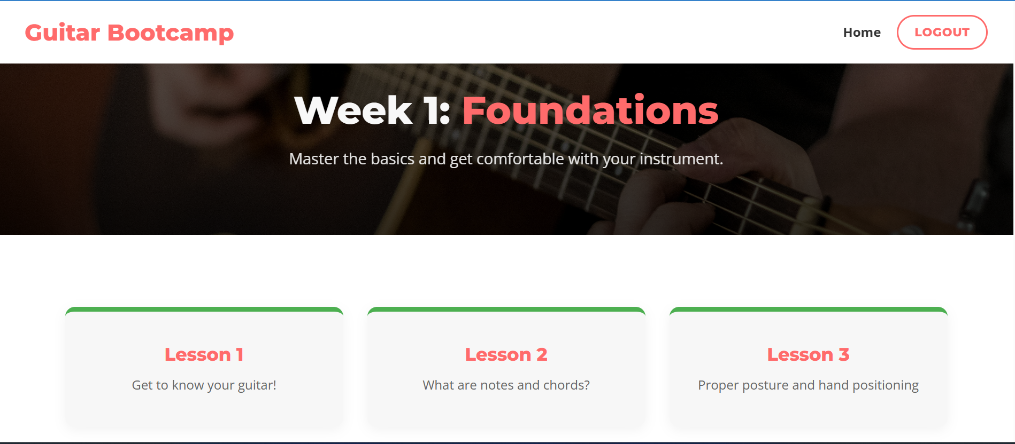
Ui design

Slide 16
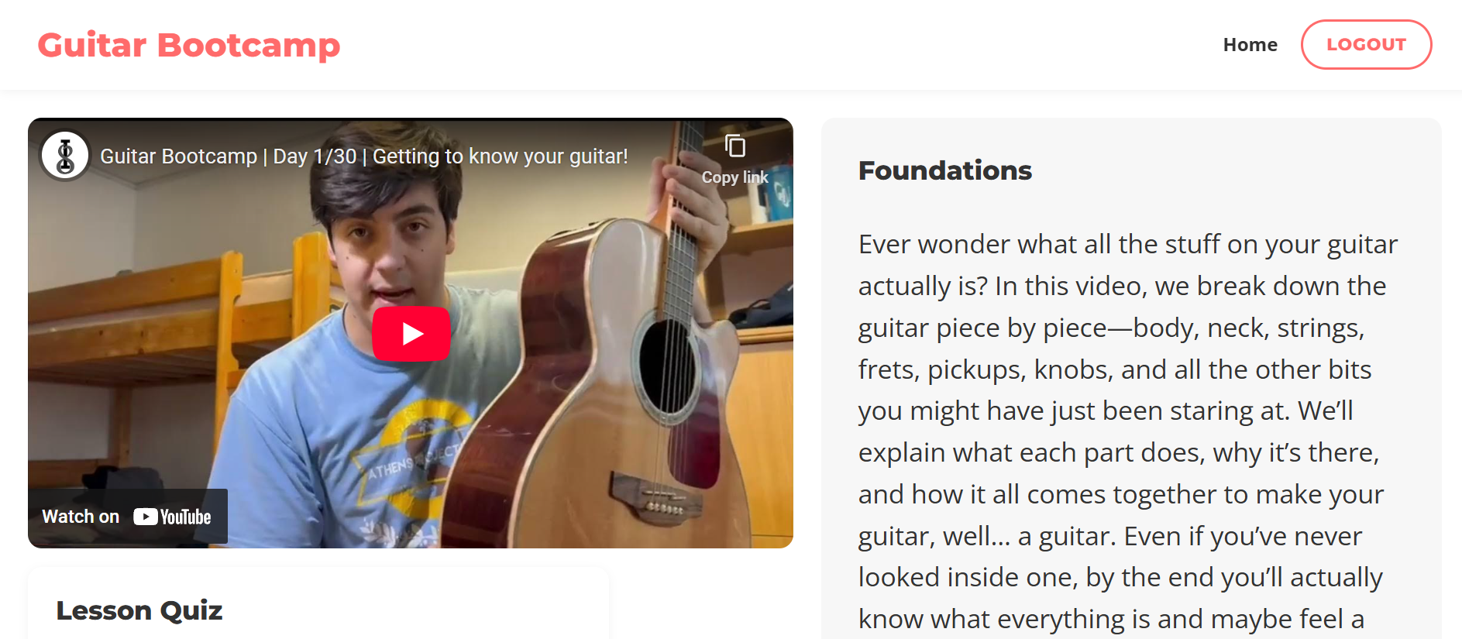
Ui design

Slide 17
Portability
The “30-Day Guitar Bootcamp” website is designed specifically for use on PC web browsers. The application runs directly in the browser and does not require installation.
10.1 Platform Portability
The website can operate on any desktop operating system that supports a modern browser, including:
Windows
macOS
Linux
10.2 Browser Portability
The platform is compatible with all major desktop browsers, such as:
Google Chrome
Mozilla Firefox
Microsoft Edge
Safari (macOS)
The system uses standard web technologies (HTML, CSS, JavaScript), ensuring consistent behavior across these browsers.
10.3 Server Portability
The backend (JavaScript + PostgreSQL) can be deployed on various server environments, including Linux, Windows Server, and cloud hosting services. This ensures flexibility for deploying and maintaining the application.
10.4 Limitations
Not optimized for mobile devices (phones/tablets).
Certain features may not work correctly on outdated or unsupported desktop browsers.

Slide 18
Competing Software
Yousician
Rocksmith+
Justin Guitar
And others..

